Slide 1
Hydroponics 101
Basics of Hydroponics with Community Complexity

Slide 2
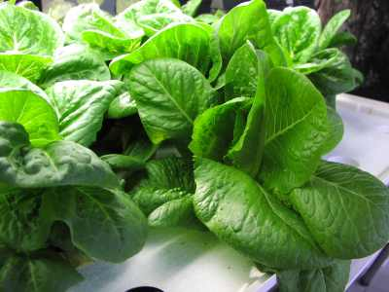
What is Hydroponics?
The word, Hydroponic, is the Latin word for ‘working water’. Simply put, it is the process of growing plants without soil.

Slide 3
Why Hydroponics?
Plant production is essentially dependant on culture medium and conditions. Naturally, soil acts as a mineral nutrient medium for plants. However, if an artificial medium is used and the optimum amount of a nutrients are added to the growing solution, one may be able to recreate plant growth and even fasten it. This is the premise of hydroponic cultivation.
Principle Advantages
Hydroponics cultivation allows for a more efficient use of water and nutrients. The crop is isolated from potentially problematic soil conditions, such as: nutrient availability, water content, disease, and salinity. Lastly, this cultivation practice minimizes used land area.
Principle Disadvantages
Traditionally, the high cost of capital and energy required to maintain controlled culture conditions often makes it impractical. Due to this, many successful food production applications are limited to countries that already have no food production problems. Additionally, pathogens will thrive well in nutrient rich solution because of the high total organic carbon (TOC) found in the plant root exudates. These TOC exudates can feed pathogenic microorganisms and cause disease outbreaks.

Slide 4
The Processes
Nutrient Solution Steps
Nutrients are added to water in a reservoir
Water from the reservoir is distributed to the plants in the system
The nutrients are sucked up by the plants’ roots
Water from the system is returned to the reservoir
Plant Steps
Seeds are placed in growth medium
Growth medium is placed in starter pots
Plants are transplanted into the system when ready
Plants absorb appropriate light and nutrients until harvested

Slide 5
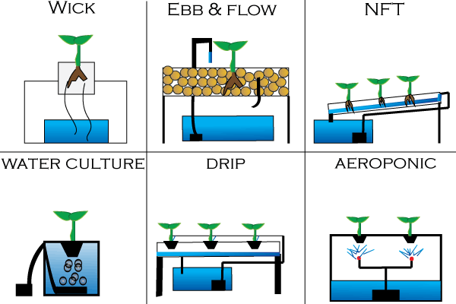
Water Distribution
Water from the reservoir is distributed to the plants in the system
Water from the system is returned to the resevoir
How do you distribute the water?
There are several ways to distribute the nutrient solution throughout the system and that is the main difference in the many different types of hydroponic systems.

Slide 6
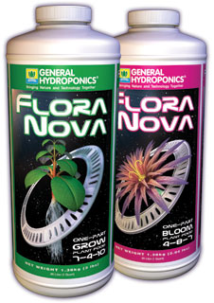
Nutrient Solution
Nutrients are added to the water in the reservoir
What kind of nutrients are added and how do you decide how much is right?
While flowering or fruit bearing plants might require nitrogen during the stem and foliage stage and calcium and phosphorus during the flowering stage, lettuce needs only nitrogen to ensure productive leaf growth. Specific formulation to use is dependent on temperature, sunlight, and daylength. A typical nutrient solution for lettuce follows similarly to this:
Ca: 180-200 ppm
P: 50 ppm
Fe: 3-5 ppm
Zn: 0.1 ppm
Mg: 40-50 ppm
Ammonium-N: 15 ppm
Mn: 0.5 pm
B: 0.5 ppm
K: 210 ppm
Nitrate-N: 165 ppm
Cu: 0.1 ppm
Mo: 0.05 ppm
A lettuce hydropnics system should operate at about 5.5 to 5.8 pH
A company called General Hydroponics sells a pH neutral nutrient solution with all of the nutrients listed to the left in a plant-averaged ratio approximation
FLORA NOVA GROW: Works as a specialized nutrient for rapidly growing plants during the structural and foliar growth phase.
FLORA NOVA BLOOM: Promotes explosive flowering and fruiting. FloraNova Bloom induces phenomenal aroma, taste, and colors while delivering extraordinary yields.

Slide 7
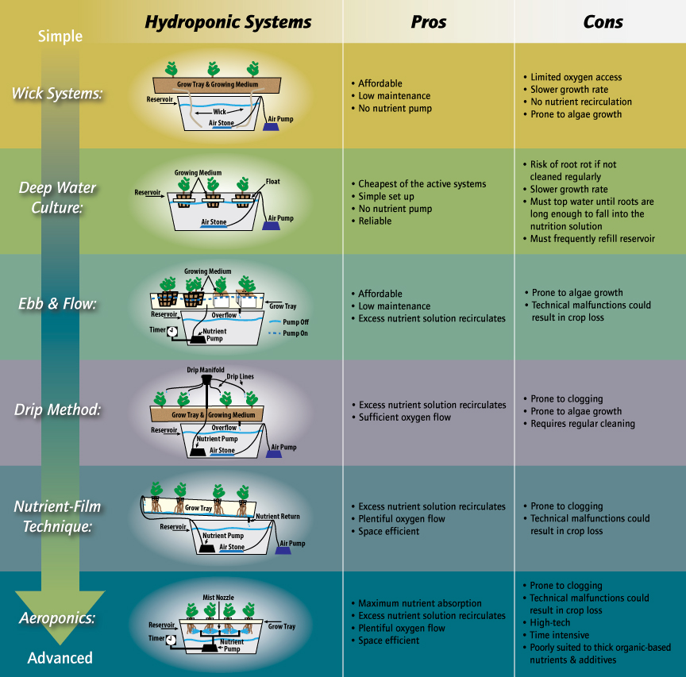
NOTE: We will only be discussing the NFT System specifically from this point forward, becuase that is the design we chose to work with (1/15 - 4/15). However, all the hydroponics system types listed can be researched independently.

Slide 9
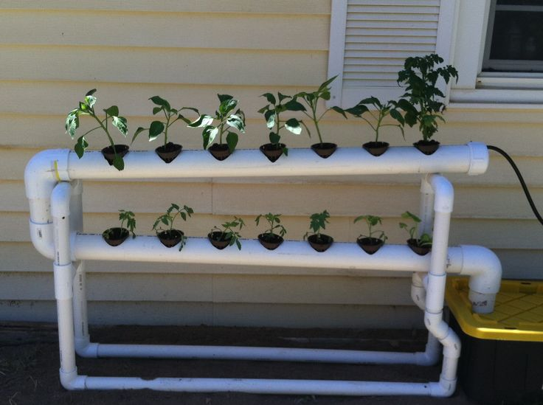
Nutrient Film Technique
Why use NFT?
A system with Nutrient Film Technique’s main benefits are it’s space efficiency and engagement. Space efficiency helps with home installations, where residents may not have a lot of space to offer. The system is just simple enough for anyone to understand, without becoming too autonomous.

Slide 10
How to build an NFT System
Get a reservoir for the nutrient solution
Get a channel for the plants to sit in
Add supports to your channel
Drill out holes in your reservoir
Get a small pump and tubing
Transplant seedlings to holes

Slide 11
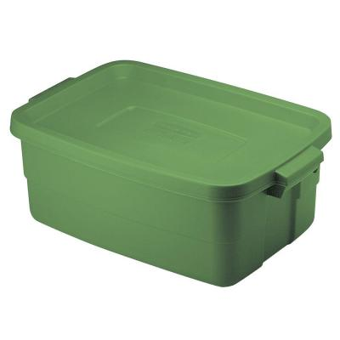
How to build an NFT System
Get a reservoir for the nutrient solution
Get a channel for the plants to sit in
Add supports to your channel
Drill out holes in your reservoir
Get a small pump and tubing
Transplant seedlings to holes
What kind of reservoir do you use for the nutrient solution?
Depending on how many plants you’re supplying with water and what style of hydroponics you are using, your reservoir can be anywhere from a small bucket to an industrial-sized tub. For the systems we’re building, we’re using a small 10-Gallon rubbermaid container (pictured top right).

Slide 12
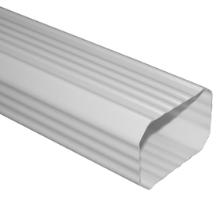
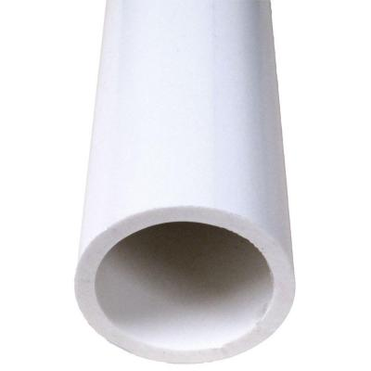
How to build an NFT System
Get a reservoir for the nutrient solution
Get a channel for the plants to sit in
Add supports to your channel
Drill out holes in your reservoir
Get a small pump and tubing
Transplant seedlings to holes

Slide 13
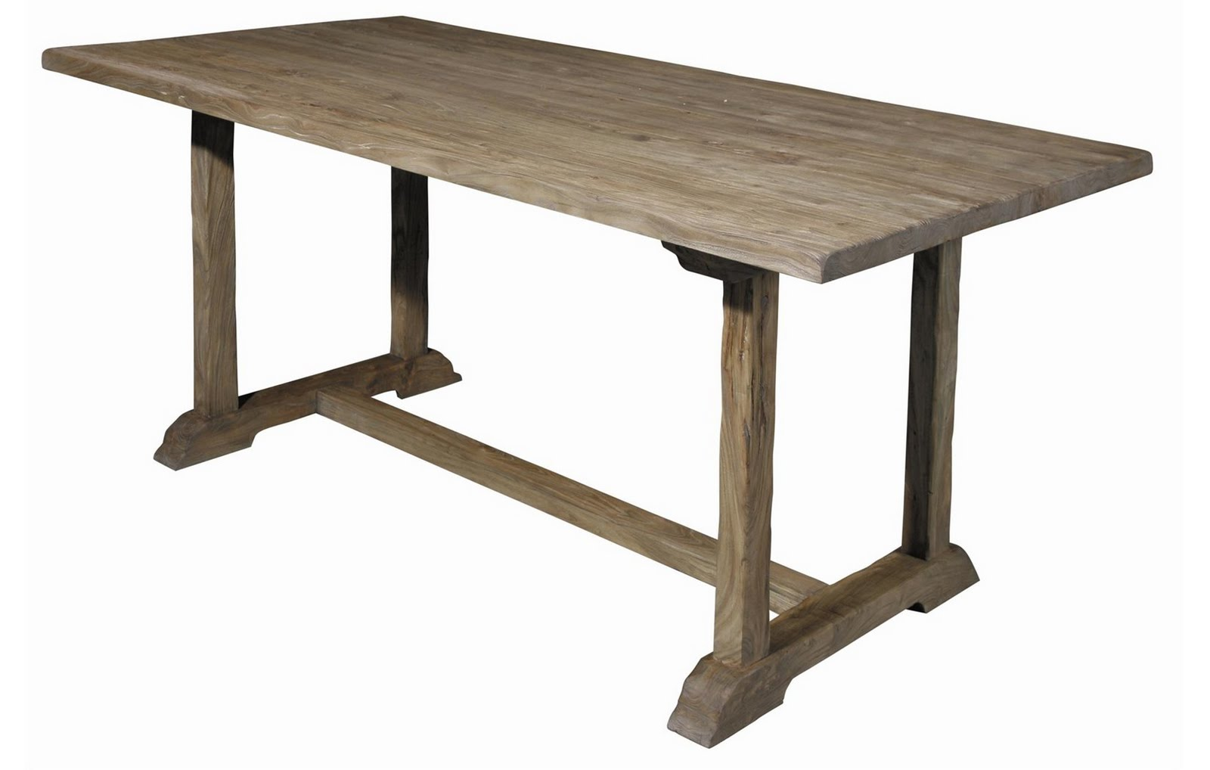
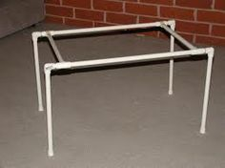
How to build an NFT System
Get a reservoir for the nutrient solution
Get a channel for the plants to sit in
Add supports to your channel
Drill out holes in your reservoir
Get a small pump and tubing
Transplant seedlings to holes
Because an NFT system depends on gravity to move the water back into the reservoir, your supports should put the channel at a slight angle (1 vertical inch / 30 horizontal inches)
1”
30”

Slide 14
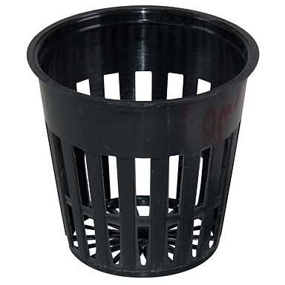
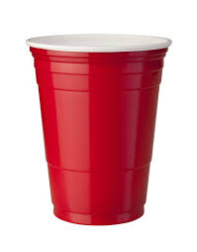
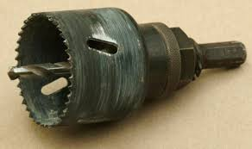
How to build an NFT System
Get a reservoir for the nutrient solution
Get a channel for the plants to sit in
Add supports to your channel
Drill out holes in your reservoir
Get a small pump and tubing
Transplant seedlings to holes
Different sized holes allow for different sized cups that hold different sized plants.

Slide 15
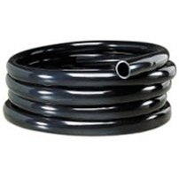
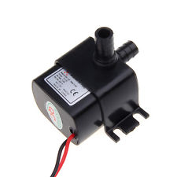
How to build an NFT System
Get a reservoir for the nutrient solution
Get a channel for the plants to sit in
Add supports to your channel
Drill out holes in your reservoir
Get a small pump and tubing
Transplant seedlings to holes
Regardless of the system, the water is normally moved from the reservoir to the plants with a small pump and vinyl tubing. The size of this tubing is determined by your pump size.

Slide 16
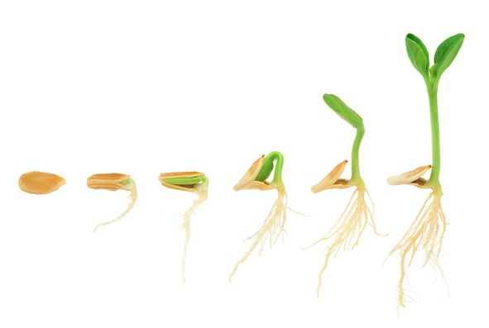
How to build an NFT System
Get a reservoir for the nutrient solution
Get a channel for the plants to sit in
Add supports to your channel
Drill out holes in your reservoir
Get a small pump and tubing
Transplant seedlings to holes
The transplanting time range (14 to 21 days) is in place, because the seedlings are to be transplanted when they reach the 2- to 3-leaf stage. Take care to not unnecessarily expose the growth medium or the seedling roots, as this could more easily lead disease infection.
It is better to transplant seedlings during low light hours of the day, as to not stress the plants during high solar conditions. Additionally, this will allow for the transplanted plant to adjust to the new location overnight and its roots will begin to grow into the nutrient solution. Within a few days the plants’ roots should begin to take hold and grow vigorously.
When do you transplant the seedling?

Slide 17
NFT Animation

Slide 18
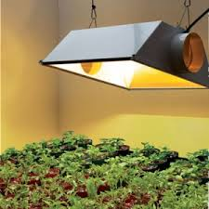
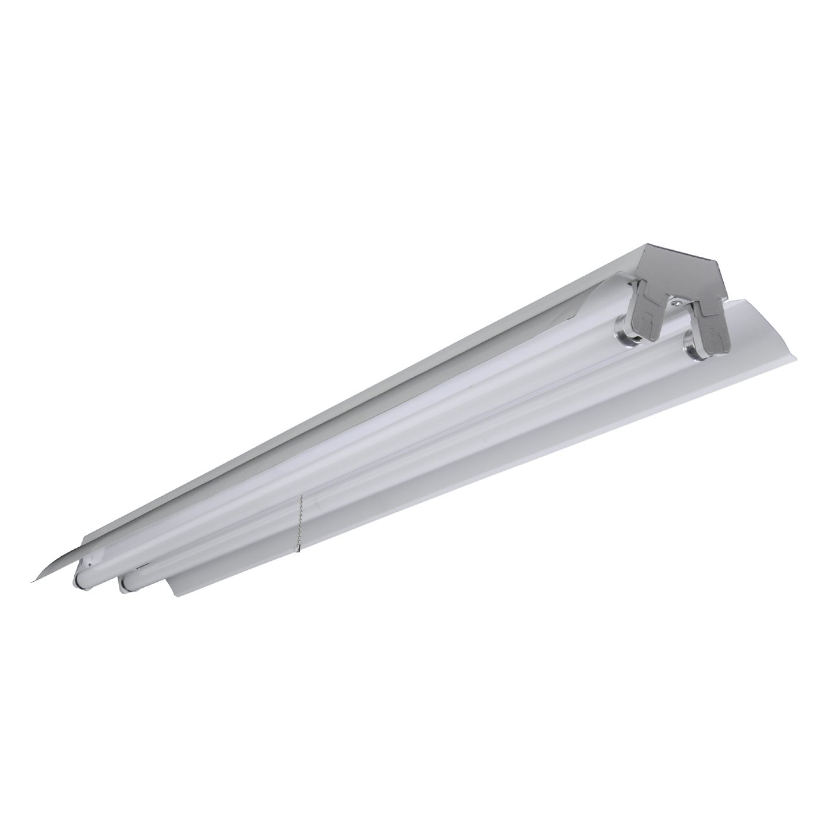
Lighting
RESEARCH: Lettuce needs 16 hours of daylight. During winter months in the northern latitudes supplementary artificial lighting is beneficial to shorten the cropping period. Optimum lighting conditions provide a minimum of 12 to 17 moles per 24-hour period. The light level should be from 400 to 800 micromoles. The important part is that the plants do receive at least 12 moles of energy per day. With higher intensity this amount of light energy may be supplied in less than 16 hours.
How do I know how much light to give my plants?
We ended up using two T8 tube fluorescents in a shoplight cover, because the lettuce we were intending to grow would easily grow with its provided light intensity.

Slide 19
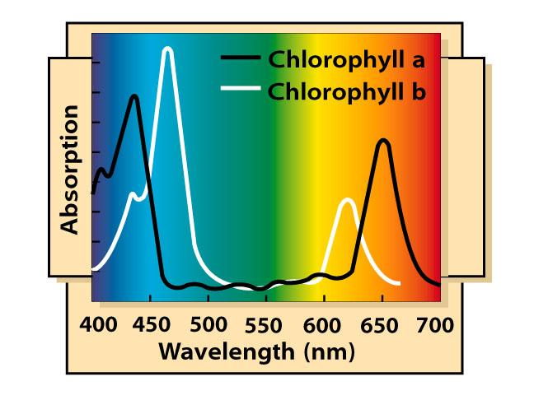
Types of Lighting
Different lighting types provide different light spectrum
Fluorescent lights can sustain leafy plants
Cheapest option
HPS can support flowering and fruiting plants
More expensive

Slide 20
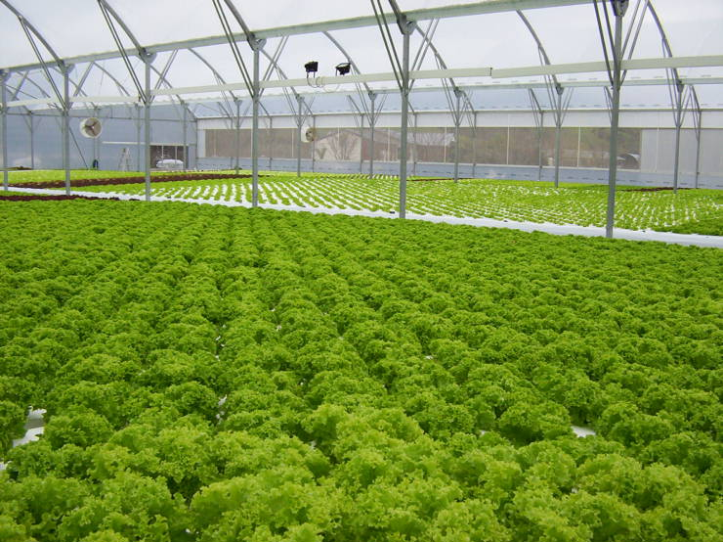
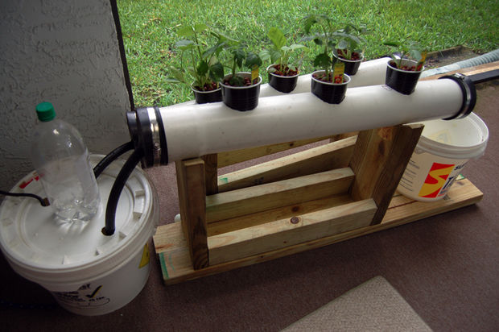
Hydroponics in Communities
AN ISSUE OF SCALE
Which scale is more viable within a community?
Who can afford each of these scales?

Slide 21
Hydroponics in Communities
GOAL
Increasing community resilience by connecting residents with healthy and affordable local food
Methods - How do we…
“Piggy-back” existing social networks, with ‘good fit’ food resilience functionality?
What social networks exist within food-troubled communities that provide trust
Create local seasonal calendars for land management food production, harvest and distribution?
How do we get everyone connected so that surplus can efficiently make it to those who need it
Provide practical education and personal empowerment happening hand-in-hand with growing food?
As we increase scale, will less people understand how hydroponics works
Enrich regional food economies - increasing local and household wealth through growing surplus?
How does this affect local farmers?
Remain equitable throughout all these efforts?
Will the people whom can afford to give there time to these efforts only be those without food security issues?

